Slide 1

BT1010 Introduction to Life Sciences
Lecture 1: Introduction to Life Sciences,
Biomolecules: Carbohydrates and Lipids
Course Instructor:
Dr. Gunjan Mehta, Ph.D.
Assistant Professor
BT314, Department of Biotechnology
IIT Hyderabad
(M.) +91 70168 96886
Email: gunjanmehta@bt.iith.ac.in

Slide 2
Course Schedule – BT1010-Oct-Nov 2025
Lecture | Date | Topic
1 | 15/10/2025 | Dr. Savita Devi_Lecture 1
2 | 16/10/2025 | Dr. Savita Devi_Lecture 2
3 | 20/10/2025 | Diwali Holiday
4 | 22/10/2025 | Dr. Savita Devi_Lecture 3
5 | 23/10/2025 | Introduction to Life Sciences, Biomolecules: Carbohydrates
6 | 27/10/2025 | Biomolecules: Proteins, enzymes, protein engineering
7 | 29/10/2025 | Biomolecules: Lipids
8 | 30/10/2025 | Biomolecules: Nucleic Acids and DNA-Based Information Technologies
9 | 3/11/2025 | Cell Organelles and Nuclear Organization
10 | 5/11/2025 | Guru Nanak Jayanti Holiday
11 | 6/11/2025 | Microscopy to Visualize Cellular Processes
12 | 10/11/2025 | Dr. Savita Devi_Lecture 4
13 | 12/11/2025 | Dr. Savita Devi_Lecture 5
14 | 13/11/2025 | Dr. Savita Devi_Lecture 6
15 | 17/11/2025 | Quiz (25 points) MCQs

Slide 3

Instructor’s Biodata
Dr. Gunjan Mehta
Assistant Professor (2020-now)
Laboratory of Chromosome Dynamics and Gene Regulation
Department of Biotechnology
IIT Hyderabad, India
(M.) +91 70168 96886
Email: gunjanmehta@bt.iith.ac.in
Lab webpage: www.mehtalab-iith.com
Education:
2003-2006 B.Sc. Biochemistry, St. Xavier’s College, Ahmedabad, Gujarat, India
2007-2009 M.Sc. Microbiology, M.S. University of Baroda, Vadodara, Gujarat, India
2009-2015 Ph.D. Biosciences and Bioengineering, IIT Bombay, Mumbai, Maharashtra, India
Professional Experience:
2015-2020 Post-Doctoral Fellow at the National Institutes of Health (NIH), MD, USA
Research Interests:
Chromosome Dynamics, Gene Regulation, Single-Molecule Imaging, Genetic Disorders, Cancer

Slide 4
Instructions
All images and videos shown during this course are copied from online resources and books for the educational purpose only.
Don’t circulate any course material outside (to any non-registered person).

Slide 5
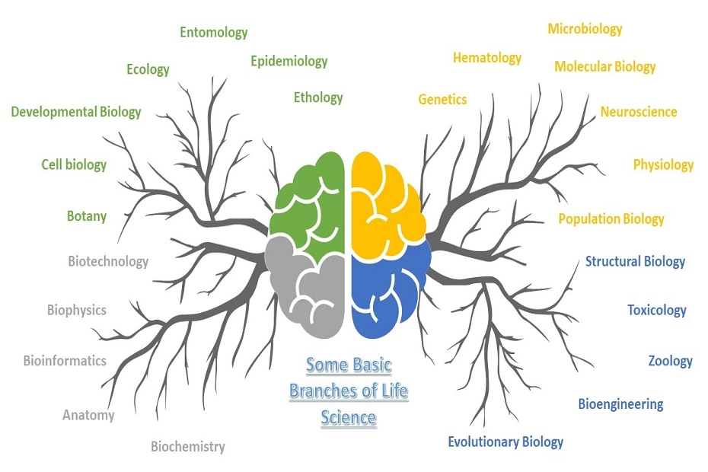
Introduction to Life Sciences (Biology)
(zoology, botany, biochemistry, microbiology, biotechnology, molecular biology, genetic engineering, genetics etc.)
Life science studies life in all its forms, past and present.
This can include plants, animals, viruses and bacteria, single-cell organisms, and even cells.
Life sciences study the biology of how these organisms live, which is why you may hear this group of specialties referred to as biology.
The simplest way to define life sciences is the study of living organisms and life processes.

Slide 6
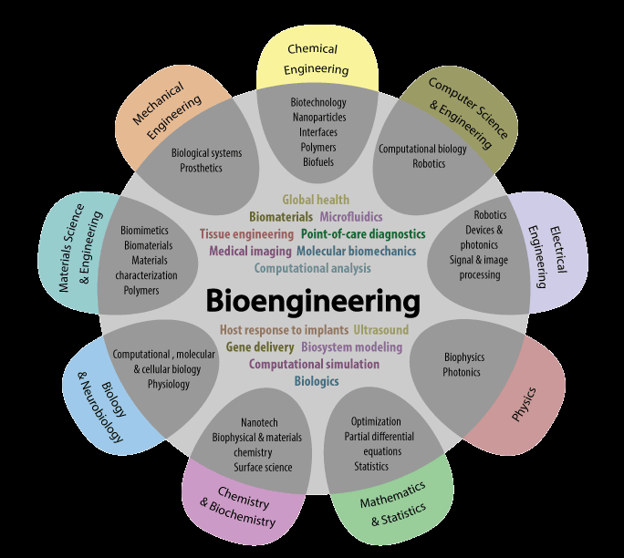
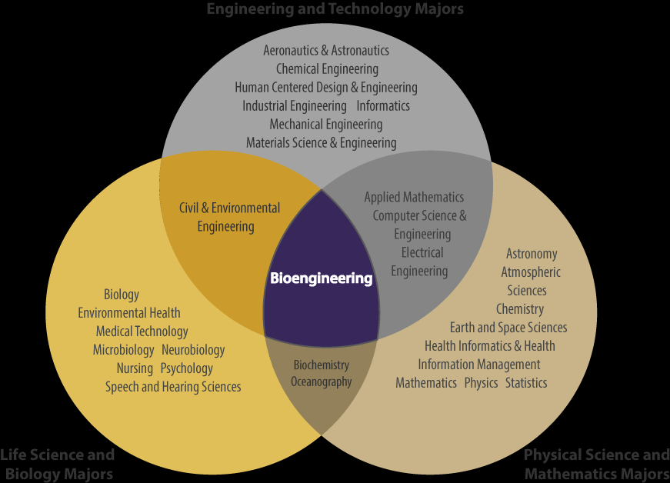
Why engineers need to study Biology/Life Sciences?
Engineering and Technology Majors
Life Science and
Biology Majors
Physical Science and
Mathematics Majors
https://bioe.uw.edu/academic-programs/about-bioengineering/

Slide 7
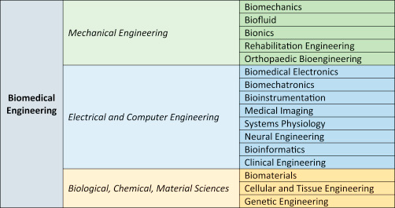
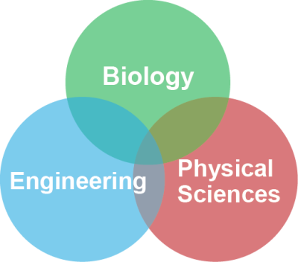
How Biology/Biomedical Engineering is linked to other disciplines of Engineering?
physics
astronomy
chemistry
earth sciences

Slide 8





So, having fundamental understanding of life sciences/Biology is important for better job prospects!
So many books on “Biology for Engineers”

Slide 9
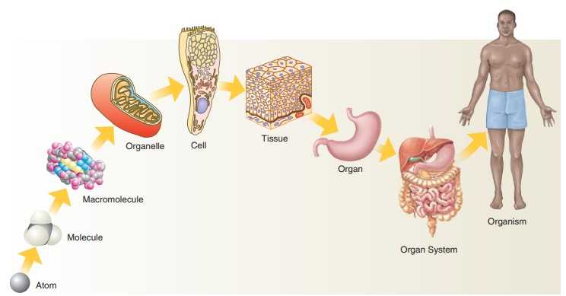
Organization level of the body
Basic unit of life
Carbohydrates: chain of sugars
Proteins: chain of amino acids
Lipids: chain of hydrocarbons
Nucleic acids: chain of nucleotides

Slide 10
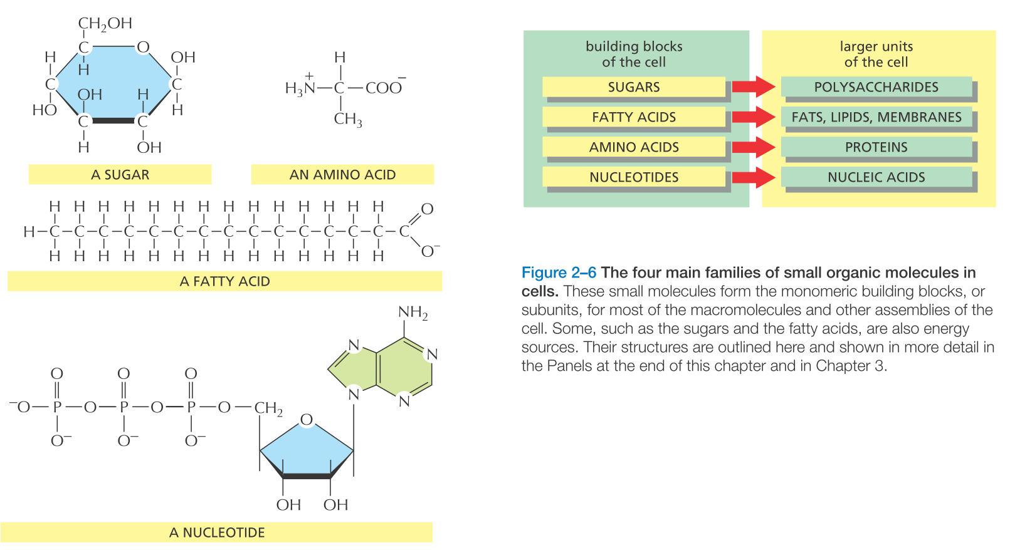
Building blocks of the macromolecules

Slide 11
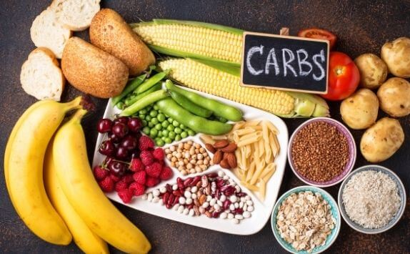
Carbohydrates

Slide 12


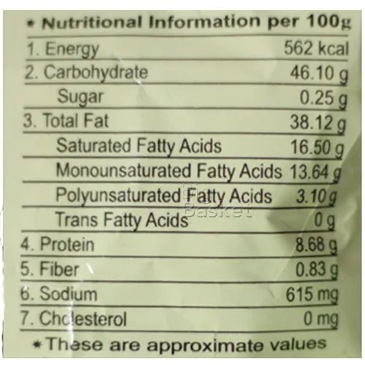
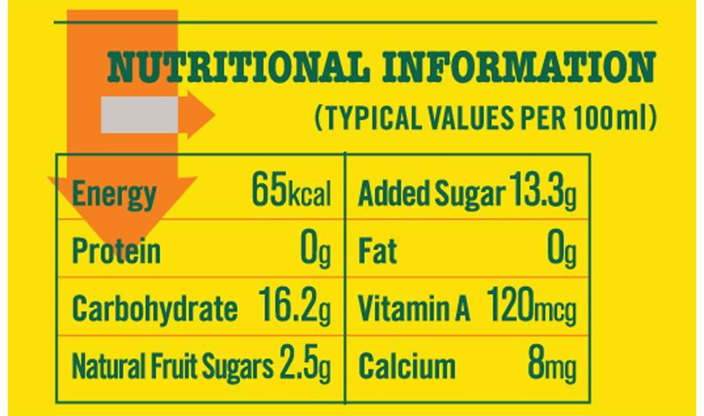
What are carbohydrates?
16.2 gm x 4 = 65 cal
46.10 gm x 4 = 184.4 cal
8.68 gm x 4 = 34.72 cal
38.12 gm x 9 = 343.08 cal
Total = 562 cal
1 gm of carbohydrates provide 4 calories.
1 gm of proteins provide 4 calories
1 gm of fats/lipids provide 9 calories
Note: Nutritional calorie is the equivalent of the kilocalorie used by chemists and biochemists. So, 65 calorie diet is the equivalent of a 65 kcal diet.

Slide 13
What are carbohydrates?
Carbohydrates, or carbs, are sugar molecules. Along with proteins and fats, carbohydrates are one of three main nutrients found in foods and drinks.
Carbohydrates are an essential macronutrient the body requires in large amounts to run smoothly.
Our digestive system breaks down carbohydrates into glucose. Glucose, or blood sugar, is the main source of energy for your body's cells, tissues, and organs. Glucose can be used immediately or stored in the liver and muscles for later use.

Slide 14
Which foods have carbohydrates?
Grains, such as bread, noodles, pasta, crackers, cereals, and rice
Fruits, such as apples, bananas, berries, mangoes, melons, and oranges
Dairy products, such as milk and yogurt
Legumes, including dried beans, lentils, and peas
Snack foods and sweets, such as cakes, cookies, candy, and other desserts
Juices, regular sodas, fruit drinks, sports drinks, and energy drinks that contain sugar
Starchy vegetables, such as potatoes, corn, and peas
Some foods don't have a lot of carbohydrates, such as meat, fish, poultry, some types of cheese, nuts, and oils.

Slide 15
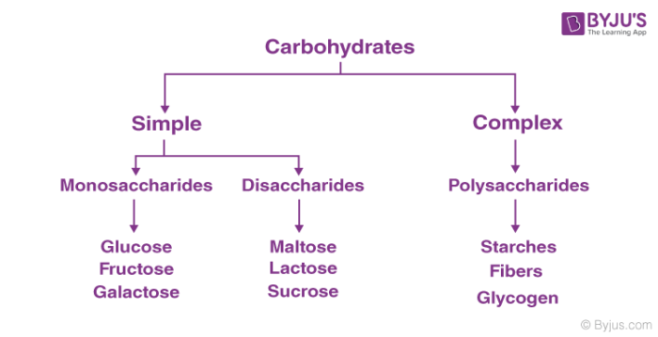
Classification of carbohydrates (Types of carbohydrates)
Carbohydrates were named from their chemical composition: carbon, hydrogen, and oxygen.

Slide 16
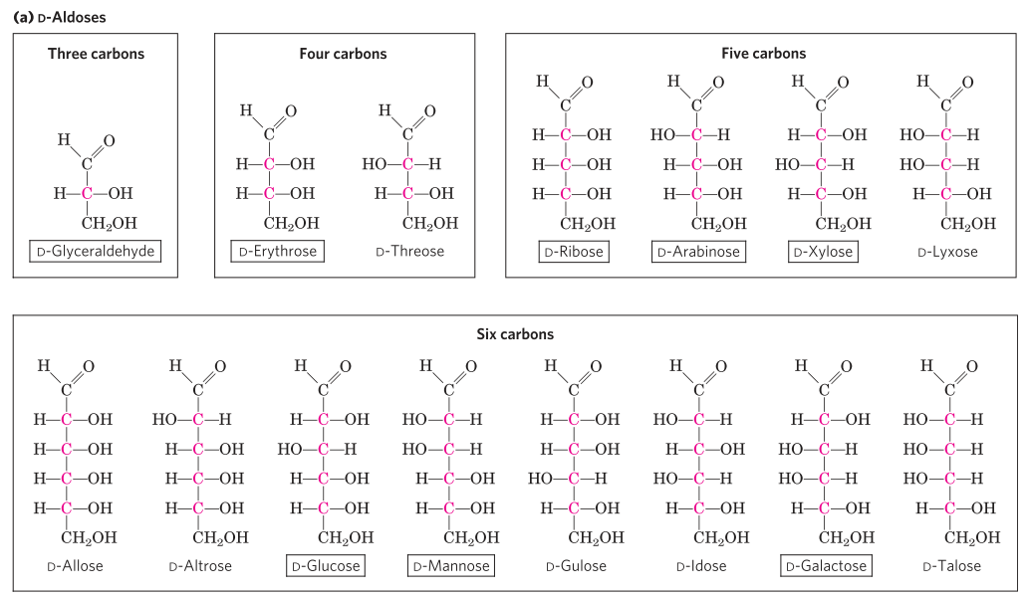
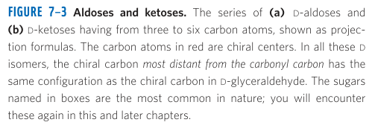
Structures of carbohydrates_Aldoses
Chiral carbon atoms are shown in pink.
Notes:
D-glucose is aldohexose sugar.

Slide 17
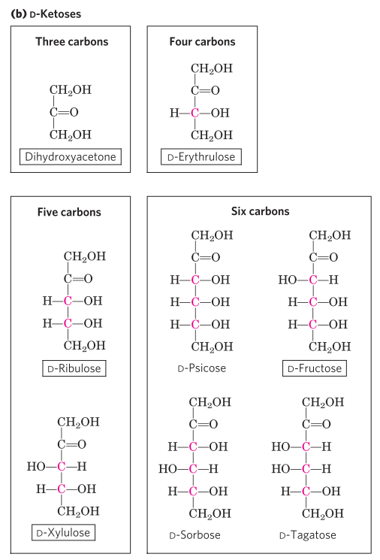
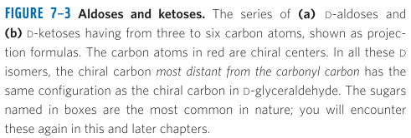
Structures of carbohydrates_Ketoses
Notes:
D-Fructose is a ketohexose sugar.

Slide 18
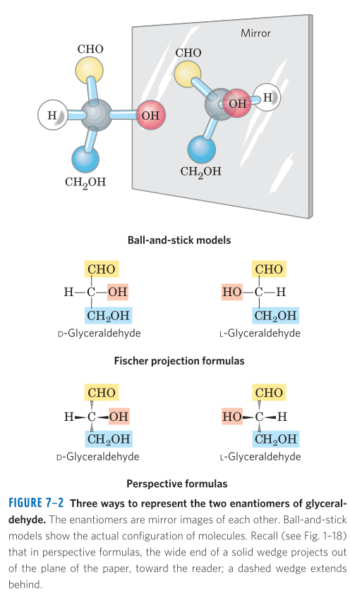
Stereoisomers of monosaccharides
Enantiomers are the mirror images of each other.
Enantiomers of Glyceraldehyde
A molecule with n chiral centers can have 2^{n} stereoisomers.
Glyceraldehyde has 2¹ =2,
Aldohexoses with 4 chiral carbons have 2⁴=16.

Slide 19
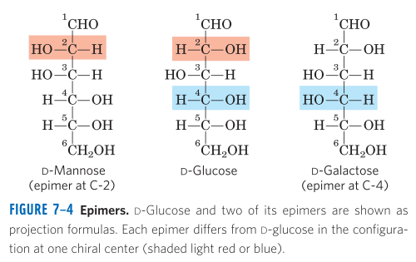
Epimers of glucose
Monosaccharides generally contain several chiral carbons and exist in a variety of stereochemical forms.
Glucose
C₆H₁₂O₆
Chiral carbon atoms are the carbon atoms that are attached to four substituents/groups.

Slide 20
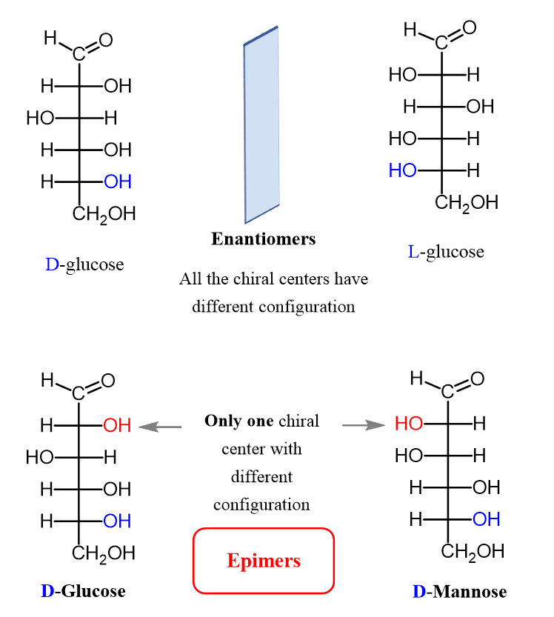
Enantiomer and Epimer of D-glucose

Slide 21
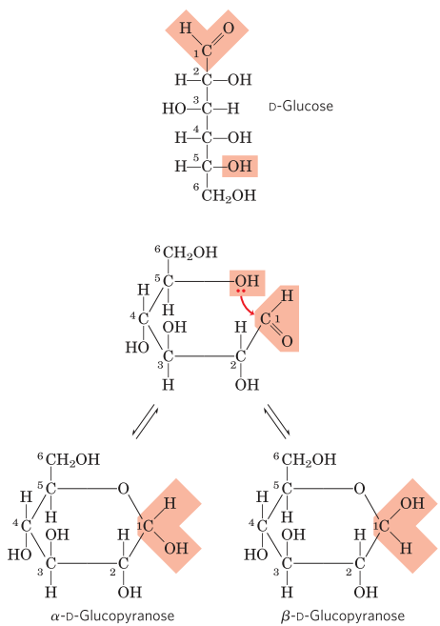
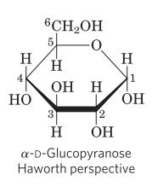
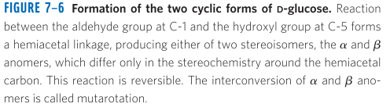
Cyclic (ring) structures of monosaccharides
In aqueous solution, monosaccharides with 5 or more carbons occur predominantly as cyclic (ring) structures.
Carbonyl group forms a covalent bond with the oxygen of a hydroxyl group along the chain.
Isomeric forms of monosaccharides that differ only in their configuration about the hemiacetal or hemiketal carbon atom are called anomers, and the carbonyl carbon is called the anomeric carbon.
Mutarotation: The interconversion of ⍺- and β- anomers is called mutarotation. This is a spontaneous process.
Anomers

Slide 22
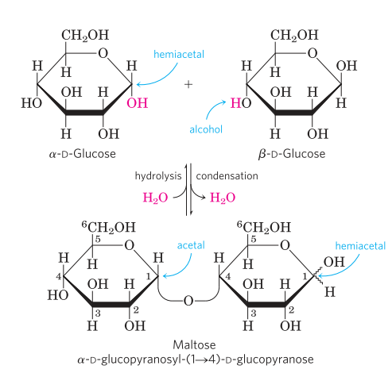
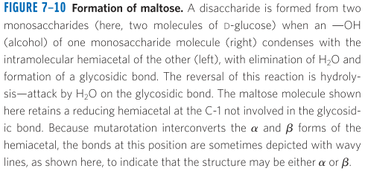
Disaccharides contain a glycosidic bond
Disaccharides (such as maltose, lactose and sucrose) consist of two monosaccharides joined covalently by an O-glycosidic bond, which is formed when a hydroxyl group of one sugar reacts with the anomeric carbon of the other.
Anomeric carbon is involved in a glycosidic bond, hence the easy interconversion of linear and cyclic forms is prevented.

Slide 23
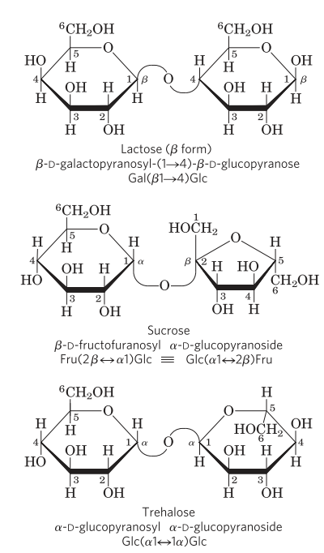
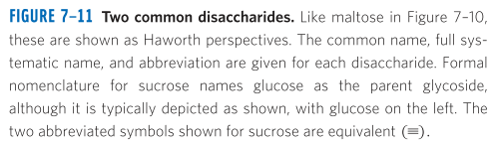
Disaccharides and their structures

Slide 24
Polysaccharides
Most carbohydrates found in nature occur as polysaccharides, polymer of medium to high molecular weight.
Polysaccharides are also known as glycans.
They serve as stored fuel (e.g. starch, glycogen) and as structural components of cell walls (cellulose, chitin, dextran) and extracellular matrix.
Homopolysaccharides contain only a single monomeric species. e.g. starch, glycogen, cellulose, chitin, dextran.
Heteropolysaccharides contain two or more different kinds. e.g. peptidoglycan,

Slide 25
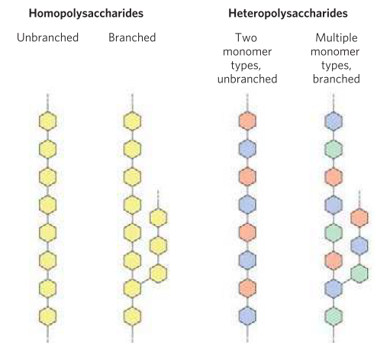

Homo- and Hetero- polysaccharides

Slide 26
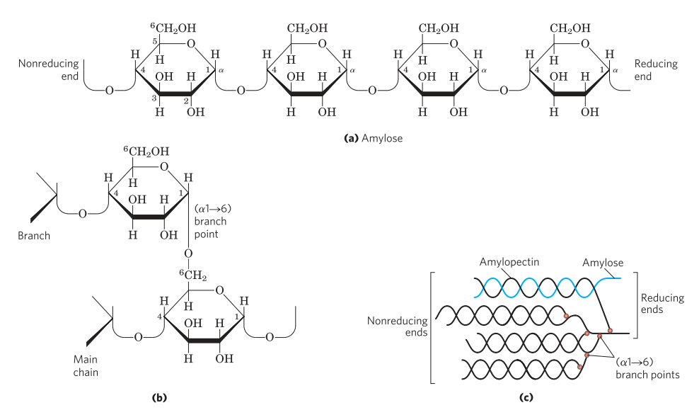
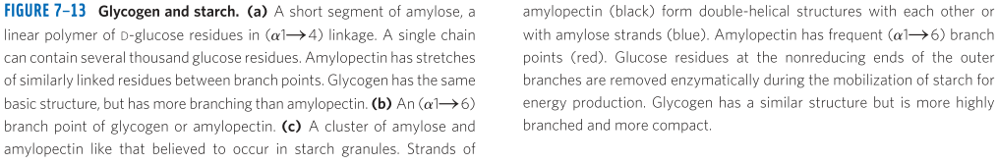
Homo- and Hetero- polysaccharides
A short segment of Amylose, a linear polymer of D-glucose residues in α1→4 linkage.
An α1→6 branch point of glycogen or amylopectin.
A cluster of amylose and amylopectin in starch granules.

Slide 27
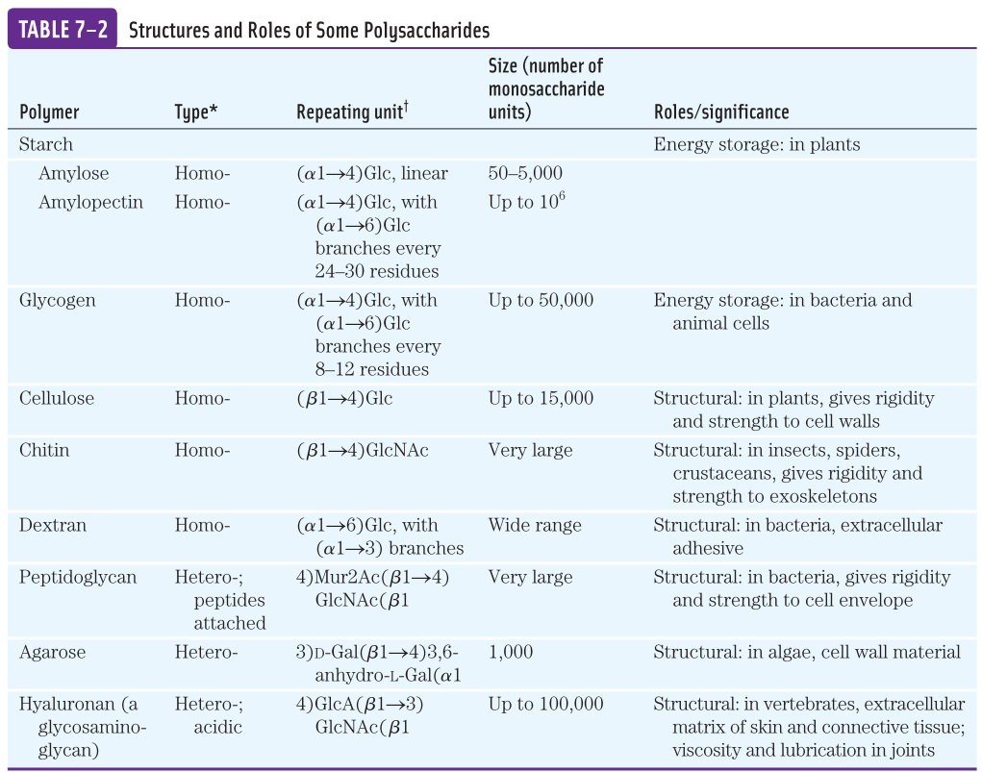

Slide 28
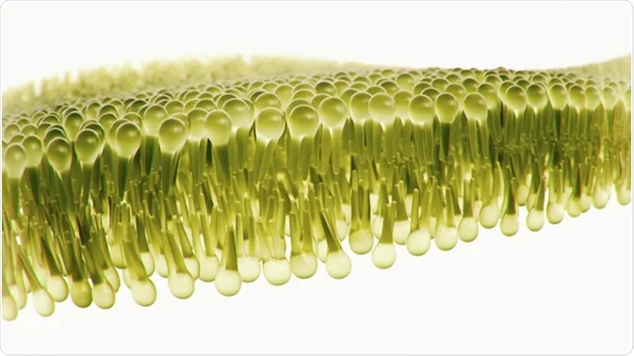
Lipids

Slide 29
What are Lipids?
Biological lipids are chemically diverse group of compounds, which are insoluble in water.
Fats and oils are the stored form of energy.
Phospholipids and sterols are major structural elements of biological membranes.
Other lipids are hormones, enzyme cofactors, light absorbing pigments, electron carriers, intracellular messengers.

Slide 30
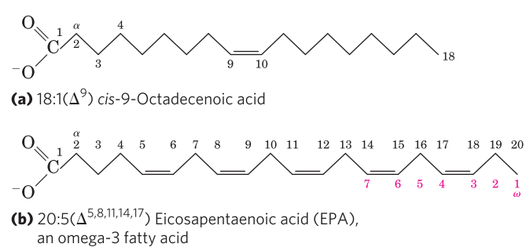
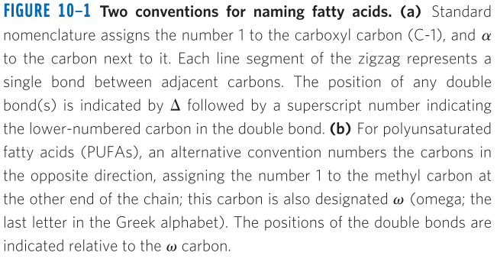
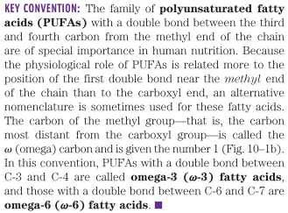
Fatty Acids
The fats and oils used as stored forms of energy are derivatives of fatty acids.
Fatty acids are hydrocarbon derivatives. They are carboxylic acids with hydrocarbon chains ranging from 4 to 36 carbons long (C4 to C36).
In some fatty acids, this chain is unbranched and fully saturated (no double bonds).
16-carbon saturated palmitic acid is abbreviated 16:0
18-carbon oleic acid, with one double bond is abbreviated 18:1.
PUFA: Polyunsaturated fatty acid

Slide 31
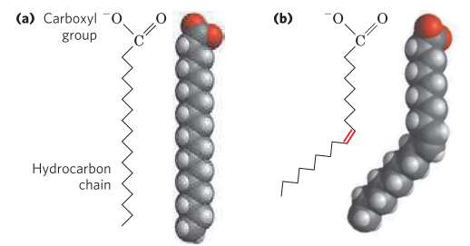
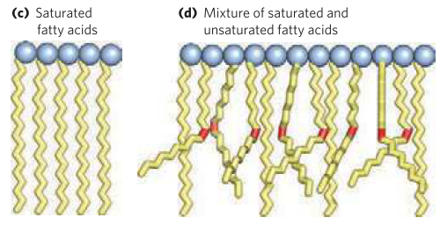
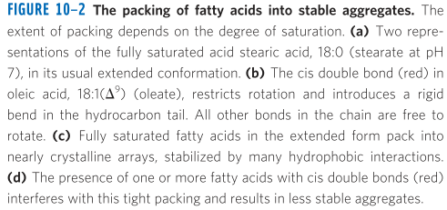
Physical properties of the fatty acids
The physical properties of the fatty acids are determined by the length and degree of unsaturation of the hydrocarbon chain.
The nonpolar hydrocarbon chain accounts for the poor solubility of fatty acids in water.
The longer the fatty acyl chain and the fewer the double bonds, the lower is the solubility in water.
The carboxylic acid group is polar and accounts for the slight solubility of short-chain fatty acids in water.
Melting points are also influenced by the length and degree of unsaturation of hydrocarbon chain.
At room temperature, the saturated fatty acids from 12:0 to 24:0 have a waxy consistency, whereas unsaturated fatty acids are oily liquids.
In unsaturated fatty acids, the double bond forces a kink in the hydrocarbon chain, hence they cannot pack together as tightly as fully saturated fatty acids.

Slide 32
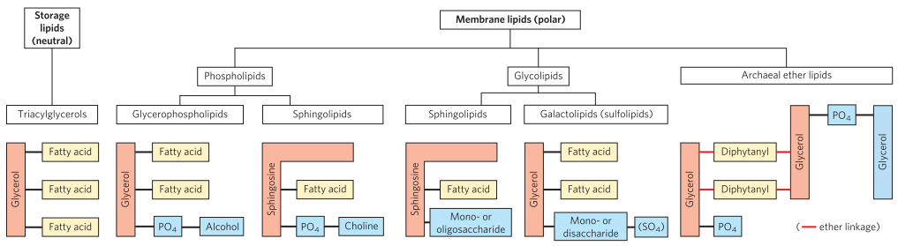
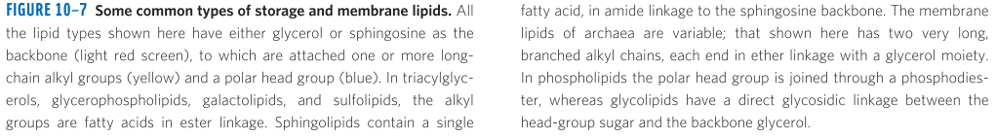
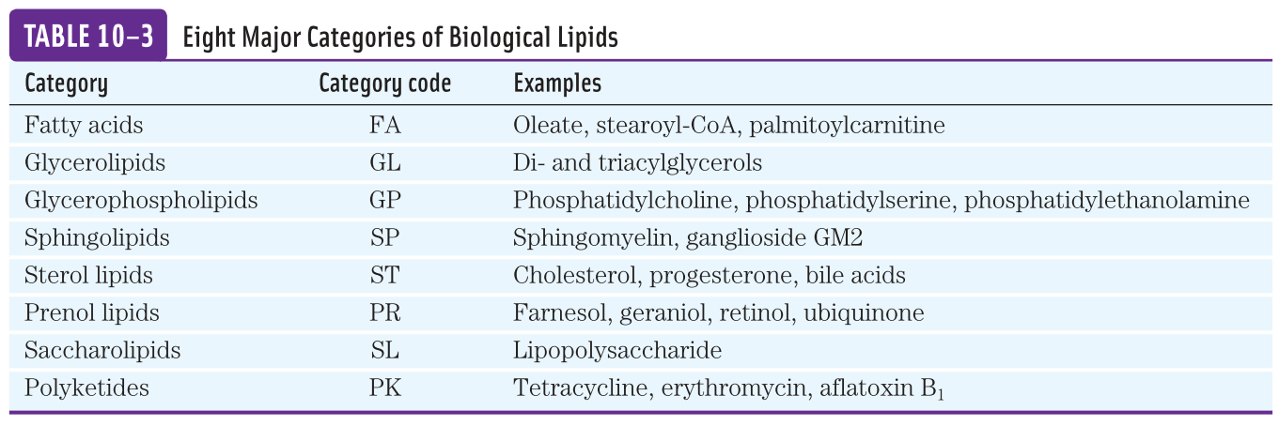
Common types of storage and membrane lipids

Slide 33
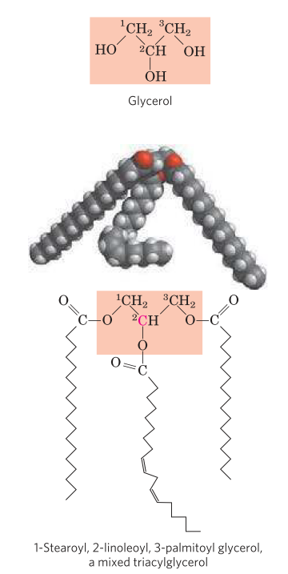
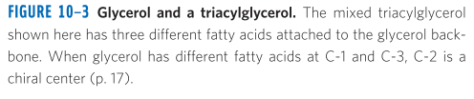
Triacylglycerols are fatty acid esters of glycerol and they serve as stored energy
The simplest lipids constructed from fatty acids are the triacylglycerols, also referred to as triglycerides, fats or neutral fats.
Triacylglycerols are composed of three fatty acids each in ester linkage with a single glycerol.
Those containing same fatty acids in all three positions are called simple triacylglycerols.
16:0, 18:0 and 18:1 are tripalmitin, tristearin and triolein.
Triacylglycerols provide stored energy and they are stored in adipocytes (fat cells). They are also stored as oils in the seed of many plants, provides energy during seed germination.
Humans have fat tissue (adipocytes) under the skin, in the abdominal cavity and in the mammary glands. Moderately obese people with 15-20 kg of triacylglycerols deposited in their adipocytes could meet their energy needs for months. In contrast, the human body can store less than a day’s energy supply in the form of glycogen.

Slide 34
Advantages of storing energy as triacylglycerols compared to polysaccharides
Oxidation of triacylglycerols provides more than twice the energy compared to glycogen:
1 gm of carbohydrates provides 4 calories.
1 gm of triacylglycerols provides 9 calories.
2) As triacylglycerols are hydrophobic (unhydrated), the organism that carries fat as fuel doesn’t have to carry the extra weight of water of hydration that is associated with stored polysaccharides (2 g per gram of polysaccharide).

Slide 35


Slide 36
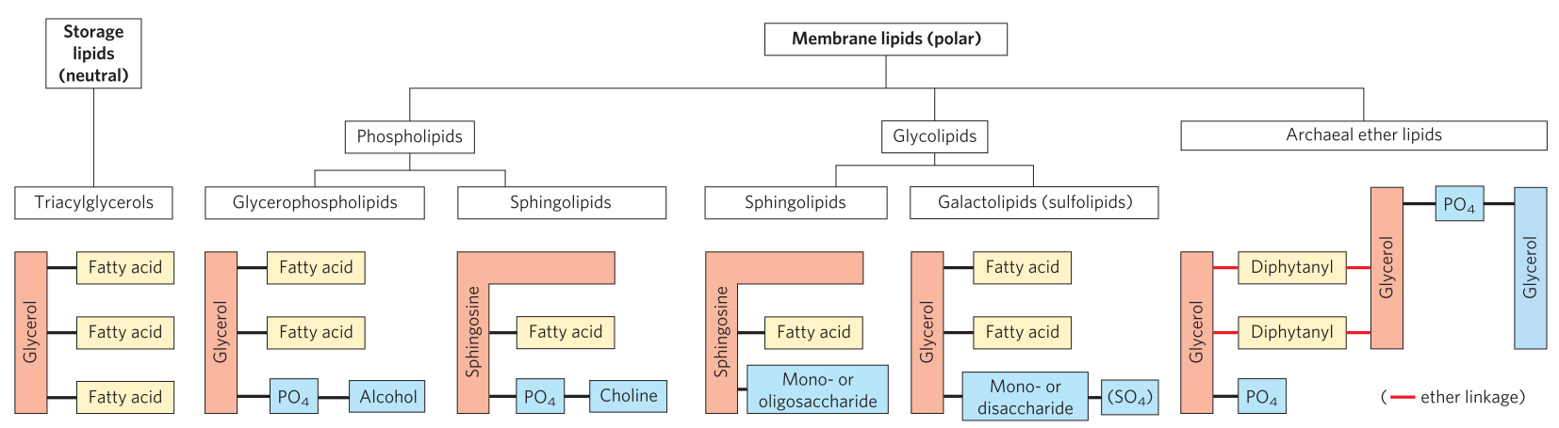
Structural Lipids in Membranes
Biological membranes (cell membrane, nuclear membrane) are made up of lipid bilayers.
Membrane lipids are amphipathic: one end is hydrophobic and the other end is hydrophilic.
Five types of membrane lipids:
glycerophospholipids: two fatty acids joined to glycerol.
galactolipids and sulfolipids: two fatty acids esterified to glycerol, but lack the phosphate of phospholipids.
tetraether lipids: two very long alkyl chains are ether-linked to glycerols at both ends
sphingolipids: a single fatty acid is joined to fatty amine, sphingosine
sterols: rigid system of four fused hydrocarbon rings.

Slide 37
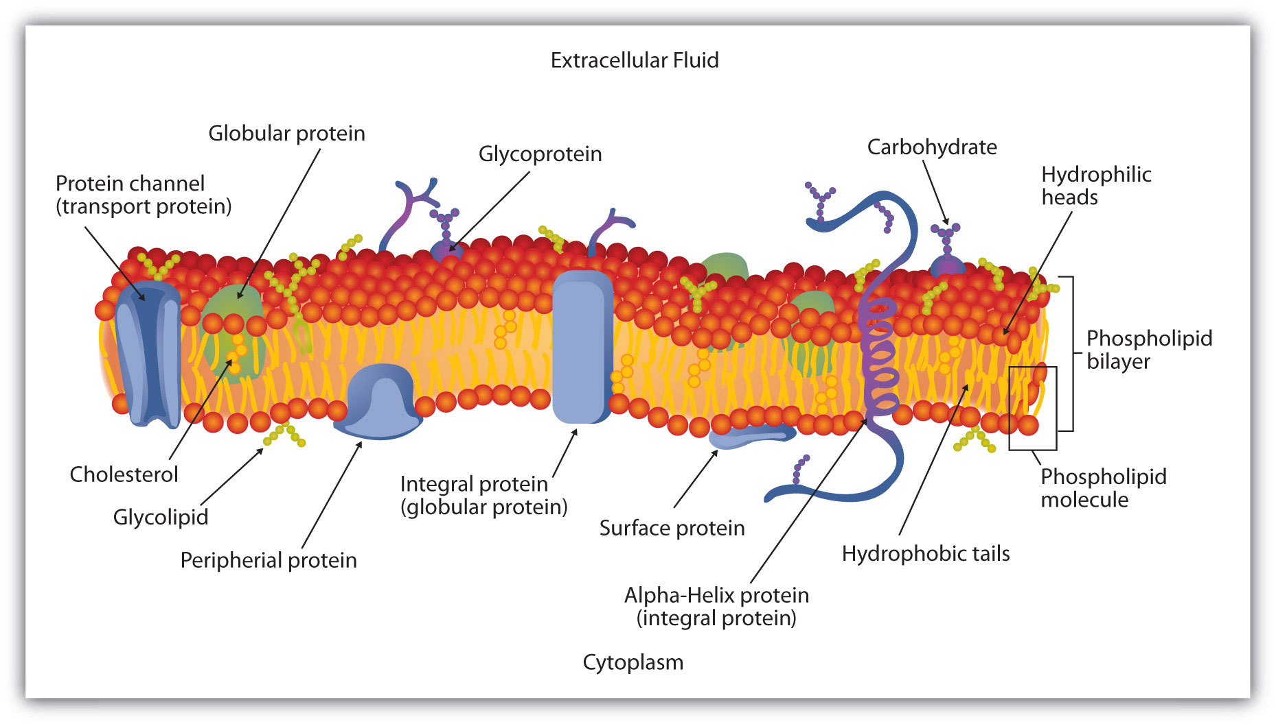
Cell Exterior
Cell interior

Slide 38
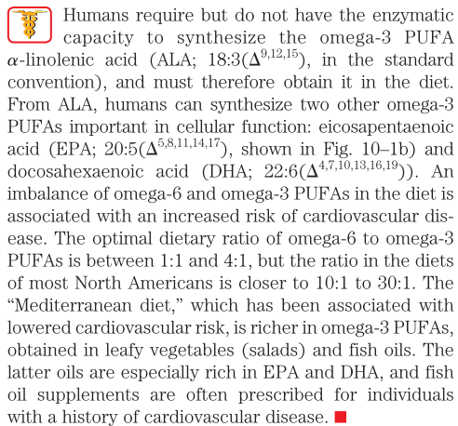
Why omega-3 PUFA are required in your diet?

Slide 39
Partial Hydrogenation of cooking oils produces trans fatty acids
When oily foods are exposed too long to the oxygen in air, they may spoil and become rancid.
The unpleasant smell and taste associated with rancidity result from the oxidative cleavage of double bonds in unsaturated fatty acids, which produces aldehydes and carboxylic acids of shorter chain length.
To improve the shelflife of vegetable oils used in cooking, partial hydrogenation is used which converts cis double bonds of fatty acids to single bonds.
Partial hydrogenation has another undesirable effect: some cis double bonds are converted to trans double bonds.
Dietary intake of trans fats leads to higher incidences of cardiovascular disease.
Dietary trans fats raise the level of triacylglycerols and of LDL (“bad”) cholesterol in the blood and lower the level of HDL (“good”) cholesterol.
Many fast foods are deep-fried in partially hydrogenated vegetable oils and therefore contain high levels of trans fatty acids. Several countries have restricted the use of partially hydrogenated oils in restaurants.

Slide 40
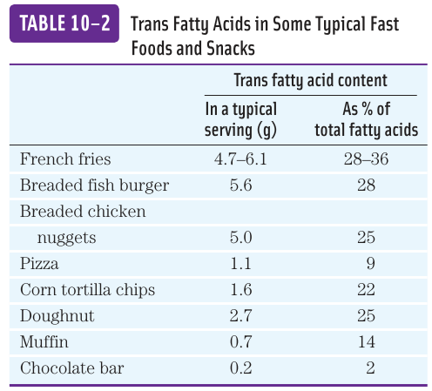

Slide 41
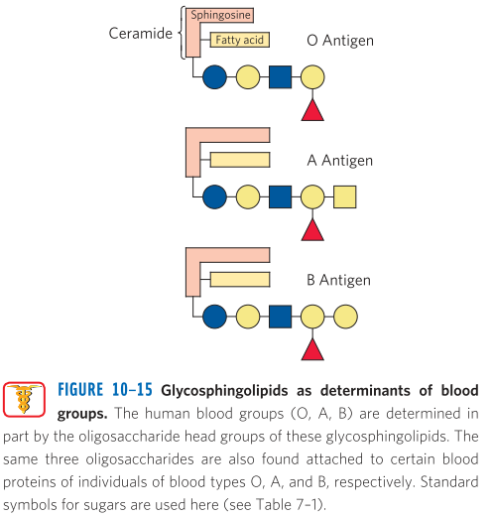
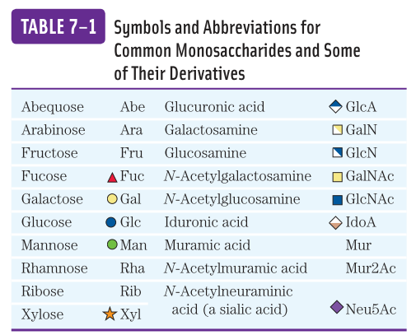
Glycosphingolipids as determinants of blood groups
Glycosphingolipids are present on the outer surface of the red blood cells (RBCs)

Slide 42
Further reading
Book: Lehninger: Principles of Biochemistry, 6th edition. ISBN: 1464109621.
Chapter 7: Carbohydrates and Glycobiology, Page 243-280.
Chapter 10: Lipids, Page 357-383.

Slide 43
Which types of carbohydrates you should eat?
You do need to eat some carbohydrates to give your body energy. But it's important to eat the right kinds of carbohydrates for your health:
When eating grains, choose mostly whole grains and not refined grains:
Whole grains are foods like whole wheat bread, brown rice, whole cornmeal, and oatmeal. They offer lots of nutrients that your body needs, like vitamins, minerals, and fiber.
Refined grains are foods that have had some parts of the grains removed. This also removes some of the nutrients that are good for your health.
Eat foods with lots of fiber. The Nutrition Facts labels on the back of food packages tells you how much fiber a product has.
Try to avoid foods that have a lot of added sugar. These foods can have many calories but not much nutrition. Eating too much added sugar raises your blood sugar and can make you gain weight.

Slide 44
What are different types of carbohydrates?
Sugars: simple carbohydrates. They can be added to foods, such as the sugar in candy, desserts, processed foods, and regular soda. They also include the kinds of sugar that are found naturally in fruits, vegetables, and milk.
Starches: complex carbohydrates. Your body needs to break starches down into sugars to use them for energy. Starches include bread, cereal, and pasta. They also include certain vegetables, like potatoes, peas, and corn.
Fiber: complex carbohydrate. Your body cannot break down most fibers, so eating foods with fiber can help you feel full and make you less likely to overeat. Diets high in fiber have other health benefits. They may help prevent stomach or intestinal problems, such as constipation. They may also help lower cholesterol and blood sugar. Fiber is found in many foods that come from plants, including fruits, vegetables, nuts, seeds, beans, and whole grains.

